Slide 1


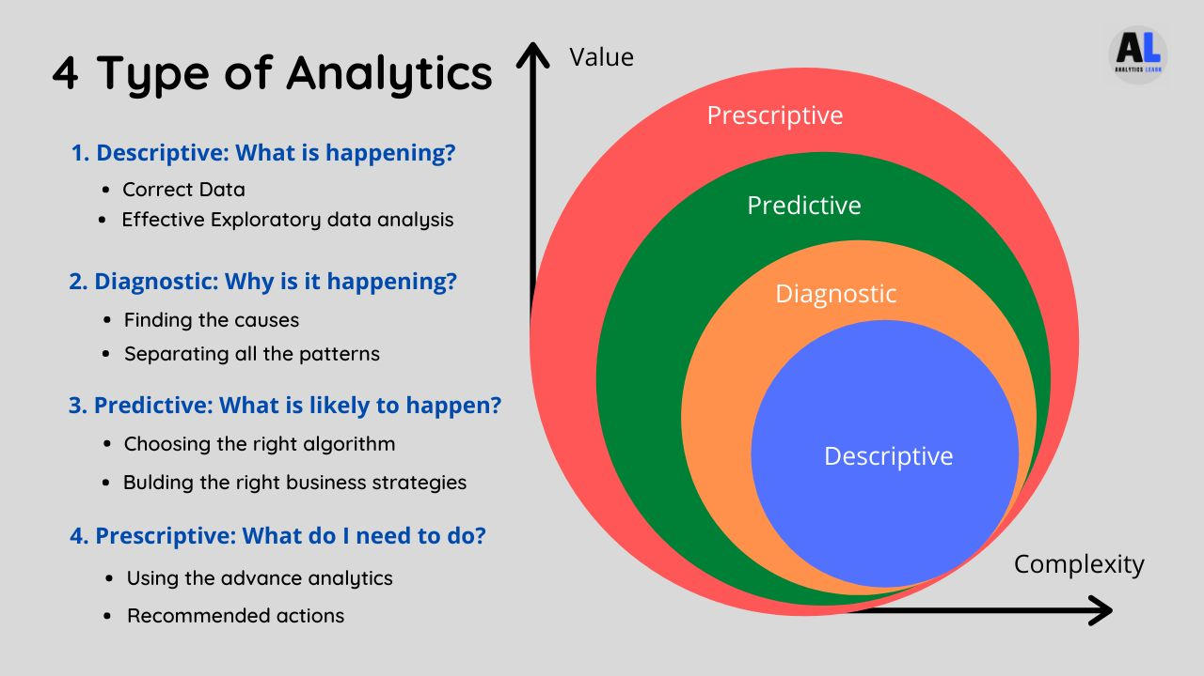
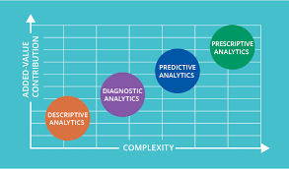
G.H.Raisoni College of Engineering and Management, Pune (An Autonomous Institute Affiliated to Savitribai Phule Pune University)
(1st Year Department)
sub:-Foundation of Data Analytics.
Types Of Data
Introduction
Analysis of data is a vital part of running a successful business. When data is used effectively, it leads to better understanding of a business’s previous performance and better decision-making for its future activities. There are many ways that data can be utilized, at all levels of a company’s operations.
There are four types of data analysis that are in use across all industries. While we separate these into categories, they are all linked together and build upon each other. As you begin moving from the simplest type of analytics to more complex, the degree of difficulty and resources required increases. At the same time, the level of added insight and value also increases.
Advantages :-
Helps you monitor the progress of your mission
Helps increase efficiency
Helps you be updated
The four types of data analysis are:
Descriptive Analysis.
Diagnostic Analysis.
Predictive Analysis.
Prescriptive Analysis.
Lack of alignment, availability and trust
Lack of Commitment
Low quality of underlying transactional data
Disadvantages :-
Guided By:-Prof.Nitesh Dangare
Presented By:-
Sushma D. Yemmewar (C-69)
Swayam P. Terode (C-70)
Tanmay R. Aswale (C-71)
Vallabh R. Shrimangale (C-72)

